Slide 1
William Stallings
Computer Organization and Architecture
8th Edition
Chapter 2
Computer Evolution and Performance

Slide 2
ENIAC - background
Electronic Numerical Integrator And Computer
Eckert and Mauchly
University of Pennsylvania
Trajectory tables for weapons
Started 1943
Finished 1946
  Too late for war effort
Used until 1955 for other purposes.
Hence need for easy re-programmability.

Slide 3
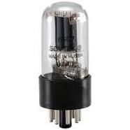
ENIAC - details
Decimal (not binary)
20 accumulators of 10 digits
Programmed manually by switches
18,000 vacuum tubes
30 tons
15,000 square feet
140 kW power consumption
5,000 additions per second
Electron tube, Vacuum tube, valve to control electron flow

Slide 4
Decimal digit implementation
One decimal digit implemented with 10 vacuum tubes arranged in a circle. 20 such circles for 20 accumulators each.
…
Each tube is connected to adjacent tubes for easy implementation of inc, dec, carry, barrow etc operations.
0
0
0
1
0
1
0
1
9
1
9
1
9
9
9
8
2
8
2
8
2
8
2
8
2
7
3
7
3
7
3
7
3
7
3
4
4
4
6
5
4
6
5
4
6
5
6
5
6
5
0
1
9
8
2
7
3
6
5
4

Slide 5
Von Neumann / Alan Turing
Stored Program concept
Main memory storing programs and data
ALU operating on binary data
Control unit interpreting instructions from memory and executing
Input and output equipment operated by control unit
Princeton Institute for Advanced Studies-IAS
Completed 1952

Slide 6
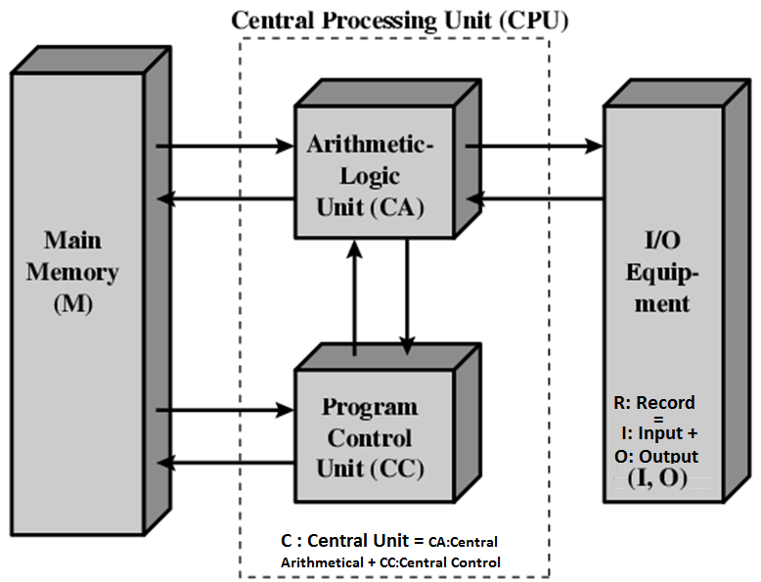
Structure of von Neumann machine

Slide 7
IAS - details
1000 x 40 bit words
  Binary number
  2 x 20 bit instructions
Set of registers (storage in CPU)
  Memory Buffer Register MBR
  Memory Address Register MAR
  Instruction Register IR
  Instruction Buffer Register IBR
  Program Counter PC
  Accumulator A
  Multiplier Quotient MQ

Slide 8
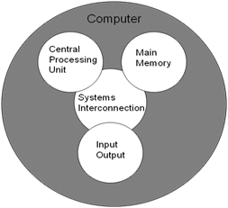
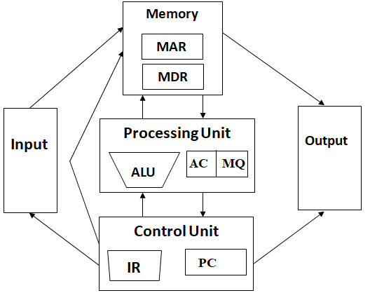
The Von-Neumann Model of a Computer
implement as

Slide 9

Structure of IAS – detailed further

Slide 10
Commercial Computers
1947 - Eckert-Mauchly Computer Corporation
UNIVAC I (Universal Automatic Computer)
US Bureau of Census 1950 calculations
Became part of Sperry-Rand Corporation
Late 1950s - UNIVAC II
  Faster
  More memory

Slide 11
IBM
Punched-card processing equipment
1953 - the 701
  IBM’s first stored program computer
  Scientific calculations
1955 - the 702
  Business applications
Lead to 700/7000 series

Slide 12
Transistors
Replaced vacuum tubes
Smaller
Cheaper
Less operating electric power required
Less heat dissipation
Solid State device
Made from Silicon (Sand)
Invented 1947 at Bell Labs
William Shockley et al.

Slide 13
Transistor Based Computers
Second generation machines
NCR & RCA produced small transistor machines
IBM 7000
DEC – 1957
  Produced PDP-1 (1959) (Programmed Data Processor)
  Produced PDP-11 (1970)
  VAX mainframe

Slide 14
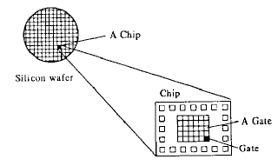
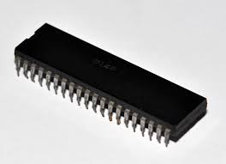
Microelectronics
Literally - “small electronics”
A computer is made up of gates, memory cells and interconnections
These can be manufactured on a semiconductor
e.g. silicon wafer

Slide 15
Generations of Computer (HW Component Based)
Vacuum tube - 1946-1957
Transistor - 1958-1964
Small scale integration - 1965 on
  Up to 100 devices on a chip
Medium scale integration - to 1971
  100-3,000 devices on a chip
Large scale integration - 1971-1977
  3,000 - 100,000 devices on a chip
Very large scale integration - 1978 -1991
  100,000 - 100,000,000 devices on a chip
Ultra large scale integration – 1991 -
  Over 100,000,000 devices on a chip

Slide 16
Moore’s Law
Increased density of components on chip
Gordon Moore – co-founder of Intel
Number of transistors on a chip will double every year
Since 1970’s development has slowed a little
  Number of transistors doubles every 18 months
Cost of a chip has remained almost unchanged
Higher packing density means shorter electrical paths, giving higher performance
Smaller size gives increased flexibility
Reduced power and cooling requirements
Fewer interconnections increases reliability

Slide 17
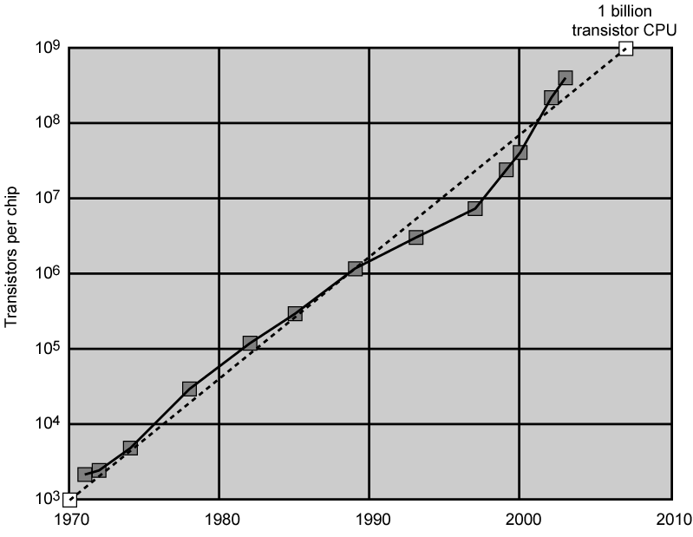
Growth in CPU Transistor Count

Slide 18
IBM 360 series
1964
Replaced (& not compatible with) 7000 series
First planned “family” of computers
  Similar or identical instruction sets
  Similar or identical O/S
  Increasing speed
  Increasing number of I/O ports (i.e. more terminals)
  Increased memory size
  Increased cost
Multiplexed switch structure

Slide 19
DEC PDP-8
1964
First minicomputer (after miniskirt!)
Did not need air conditioned room
Small enough to sit on a lab bench
$16,000
  $100k+ for IBM 360
Embedded applications & OEM
  OEM (Original Equipment Manufacturer), the reseller companies that purchase in bulk
BUS STRUCTURE

Slide 20
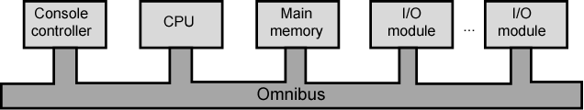
DEC - PDP-8 Bus Structure

Slide 21
Semiconductor Memory
1970
Fairchild
Size of a single core
  i.e. 1 bit of magnetic core storage
Holds 256 bits
Non-destructive read
Much faster than core
Capacity approximately doubles each year

Slide 22
Intel
1971 - 4004
  First microprocessor
  All CPU components on a single chip
  4 bit
Followed in 1972 by 8008
  8 bit
  Both designed for specific applications
1974 - 8080
  Intel’s first general purpose microprocessor

Slide 23


Slide 24
Speeding it up (Innovative changes)
Pipelining
On board cache
On board L1 & L2 cache
Branch prediction
Data flow analysis
Speculative execution

Slide 25
IP Sequence vs Dataflow Order
v <- a + b;
w <- b * 2;
x <- v-w;
y <- v + w
z <- x * y
Instructions are Fetched and executed sequentially as given by IP unless explicit control flow instruction is involved
a
b
+
*2
-
+
*
Instruction fetched & executed in dataflow order. No IP. Each instruction specify which node should receive the result. Each node fires output when inputs are ready. Here IP & Dataflow provide difference in micro-architecture.
Pipeline in also about U-architecture

Slide 26
Dataflow Order (more detail)
In a data flow machine, a program consists of dataflow node. A node fires (fetched & excuted) output when all inputs have token.
Instruction flow (ISA) representation Dataflow representation
Von Neumann CA offers precise location and state easy to debug as opposed to Data flow
Model But data flow model is more parallel suitable for pipe line Computer Architecture
Design Tradeoffs (High Level Ones)
Ease of programming (for avg programmer)?
Ease of Compilation?
Performance: Extraction of parallelism
Hardware complexity?
* | R | ARG1 | R | ARG2 | Result or Destination
*

Slide 27
ISA-level Tradeoffs: Instruction Pointer (IP)
Do we need an Instruction pointer in the ISA?
Yes: Control-driven, Sequential execution
An instruction is executed if the IP points to it
IP automatically changes sequentially (except for control flow instruction)
No: Data-driven, Parallel execution
An instruction is Executed when all its operand values are available

Slide 28
ISA: Microarchitecture Level Tradeoffs
Control or Data Driven Execution at U-ARCH?
ISA: Specify how the programmer sees instructions to be executed
Programmer sees a sequential, control-flow execution order VS
Programmer sees a dataflow execution order
U-ARCH: How the underlying implementation actually execute instructions
U-arch can execute instructions in any order as long as it obeys the semantics specified by the ISA when making the instruction results visible to software
Programmer should see the order specified by the ISA

Slide 29
Von-Neumann Model (and Modern Processors)
All major ISAs today use this model e.g., x86, ARM, MIPS, SPARC, Alpha, POWER
Underneath(at U-architecture level) the execution model all implementation (or microarchitectures) is very different.
Pipelined introduction execution: Intel 80486 uarch
Multiple instruction at a time: Intel Pentium uarch
Out-o-order execution: Intel Pentium Pro urach
Separate instruction and data caches
But, what happen underneath that is not consistent with Von Neumann model and not exposed to software.
Hence, difference between ISA and microarchitecture?

Slide 30
ISA versus Microarchitecture
ISA: Agree upon interface between software and hardware
SW/compiler assumes, HW promises
What the SW writer needs to know to write and debug system/user programs
ISA changes very slowly
Microarchitecture:
Specify implementation of an ISA
Not visible to the software?
Microprocessor
ISA, U-arch, circuits
Architecture = ISA + micro-architecture
micro-architecture changes very fast
Problem
Algorithm
Program
ISA
U-Arch
Circuit
Electrons

Slide 31
17=9=2019

Slide 32
Performance Balance of a Computer
Processor speed increased
Memory capacity increased
Memory speed lags behind processor speed

Slide 33
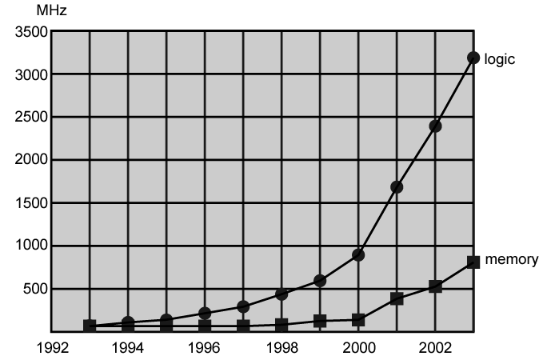
Logic and Memory Performance Gap

Slide 34
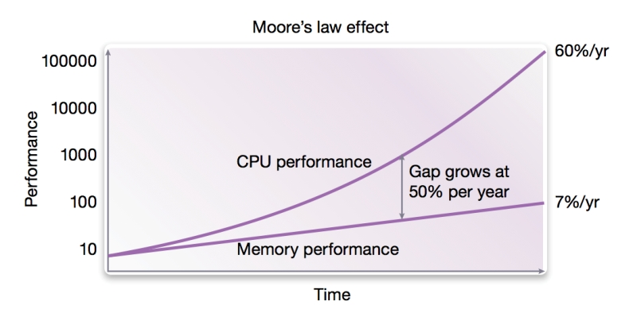
The major problem with DRAM is that while memory clock speeds have increased enormously over the past 30 years, memory latency has dropped much more slowly. Typically latency increases with every clock speed jump; DDR4-3200’s memory cell cycle time in nanoseconds is roughly on par with DDR3-1600, and DDR3-1600 is on-par with DDR-400.

Slide 35
Solutions
Increase number of bits retrieved at one time
  Make DRAM “wider” rather than “deeper”
Change DRAM interface
  Cache
Reduce frequency of memory access
  More complex cache and cache on chip
Increase interconnection bandwidth
  High speed buses
  Hierarchy of buses

Slide 36
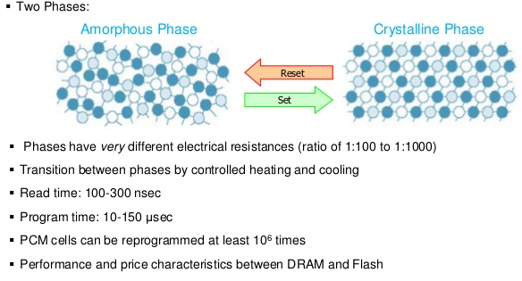
In theory, phase change memory could eventually present a solution to the so-called memory wall, or memory gap.
Phase change memory (PCM) works by shifting between two states: An amorphous state with high resistance and a crystalline state with low resistance. The question that Dr. Zalden’s team set out to answer is how quickly does phase change memory begin to change from one to the other, and whether we can take advantage of the speed.

Slide 37
I/O Devices
Peripherals with intensive I/O demands
Large data throughput demands
Processors can handle this
Problem moving data
Solutions:
  Caching
  Buffering
  Higher-speed interconnection buses
  More elaborate bus structures
  Multiple-processor configurations

Slide 38
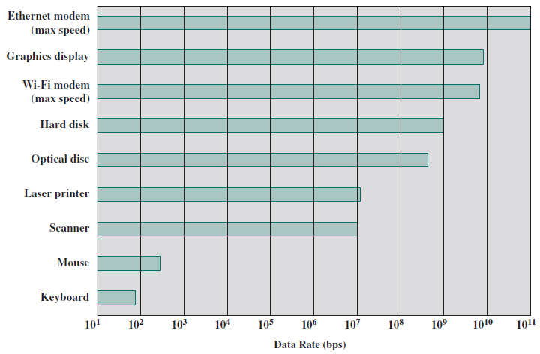
Typical I/O Device Data Rates

Slide 39
Improvements in Chip Organization and Architecture
Increase hardware speed of processor
  Fundamentally due to shrinking logic gate size
    More gates, packed more tightly, increasing clock rate
    Propagation time for signals reduced
Increase size and speed of caches
  Dedicating part of processor chip
    Cache access times drop significantly
Change processor organization and architecture
  Increase effective speed of execution
  Parallelism

Slide 40
Problems with Clock Speed and Logic Density
Power
  Power density increases with density of logic and clock speed
  Dissipating heat
RC delay
  Speed at which electrons flow limited by resistance and capacitance of metal wires connecting them
  Delay increases as RC product increases
  Wire interconnects thinner, increasing resistance
  Wires closer together, increasing capacitance
Memory latency
  Memory speeds lag processor speeds
Solution:
  More emphasis on organizational and architectural approaches

Slide 41
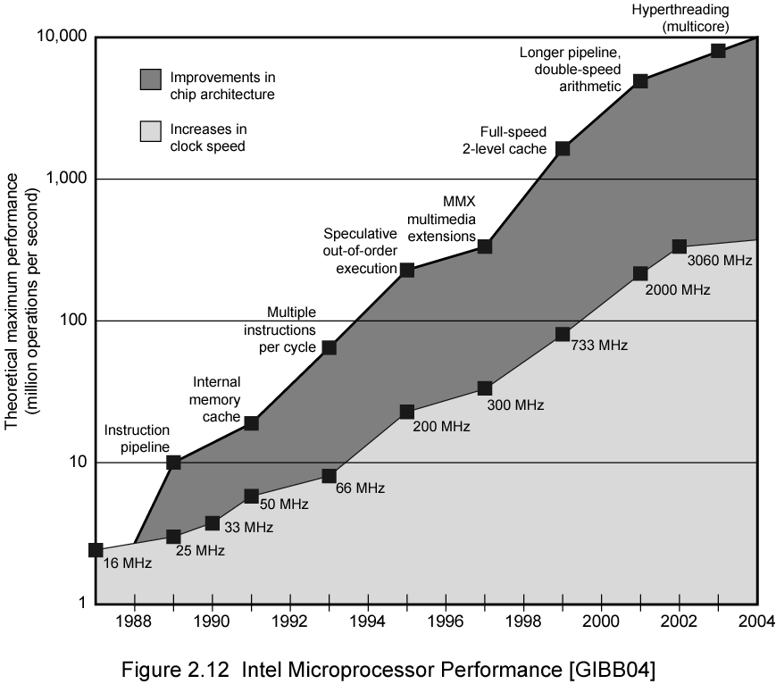
Intel Microprocessor Performance

Slide 43
Increased Cache Capacity
Typically two or three levels of cache between processor and main memory
Chip density increased
  More cache memory on chip
    Faster cache access
Pentium chip devoted about 10% of chip area to cache
Pentium 4 devotes about 50%

Slide 44
More Complex Execution Logic
Enable parallel execution of instructions
Pipeline works like assembly line
  Different stages of execution of different instructions at same time along pipeline
Superscalar allows multiple pipelines within single processor
  Instructions that do not depend on one another can be executed in parallel

Slide 45
Diminishing Returns
Internal organization of processors complex
  Can get a great deal of parallelism
  Further significant increases likely to be relatively modest
Benefits from cache are reaching limit
Increasing clock rate runs into power dissipation problem
  Some fundamental physical limits are being reached

Slide 46
New Approach – Multiple Cores
Multiple processors on single chip
  Large shared cache
Within a processor, increase in performance proportional to square root of increase in complexity
If software can use multiple processors, doubling number of processors almost doubles performance
So, use two simpler processors on the chip rather than one more complex processor
With two processors, larger caches are justified
  Power consumption of memory logic less than processing logic

Slide 47
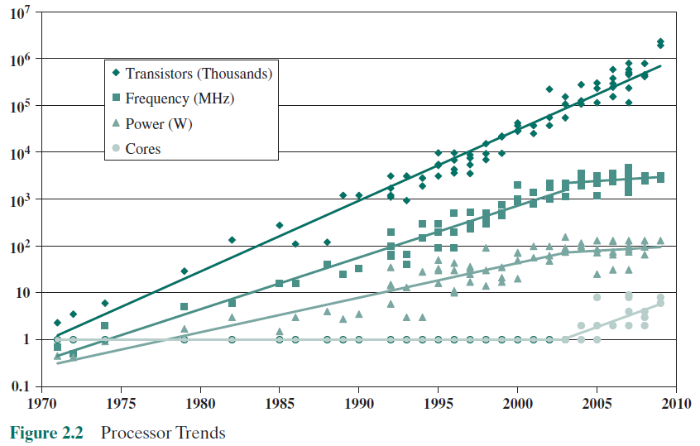
Improvements in Chip Organization and Architecture

Slide 48
x86 Evolution (1)
8080
  first general purpose microprocessor
  8 bit data path
  Used in first personal computer – Altair
8086 – 5MHz – 29,000 transistors
  much more powerful
  16 bit
  instruction cache, prefetch few instructions
  8088 (8 bit external bus) used in first IBM PC
80286
  16 Mbyte memory addressable
  up from 1Mb
80386
  32 bit
  Support for multitasking
80486
  sophisticated powerful cache and instruction pipelining
  built in maths co-processor

Slide 49
x86 Evolution (2)
Pentium
  Superscalar
  Multiple instructions executed in parallel
Pentium Pro
  Increased superscalar organization
  Aggressive register renaming
  branch prediction
  data flow analysis
  speculative execution
Pentium II
  MMX technology
  graphics, video & audio processing
Pentium III
  Additional floating point instructions for 3D graphics

Slide 50
x86 Evolution (3)
Pentium 4
  Note Arabic rather than Roman numerals
  Further floating point and multimedia enhancements
Core
  First x86 with dual core
Core 2
  64 bit architecture
Core 2 Quad – 3GHz – 820 million transistors
  Four processors on chip
x86 architecture dominant outside embedded systems
Organization and technology changed dramatically
Instruction set architecture evolved with backwards compatibility
~1 instruction per month added
500 instructions available
See Intel web pages for detailed information on processors

Slide 51
Embedded Systems
ARM
ARM evolved from RISC design
Used mainly in embedded systems
  Used within product
  Not general purpose computer
  Dedicated function
  E.g. Anti-lock brakes in car

Slide 52
Embedded Systems Requirements
Different sizes
  Different constraints, optimization, reuse
Different requirements
  Safety, reliability, real-time, flexibility, legislation
  Lifespan
  Environmental conditions
  Static v dynamic loads
  Slow to fast speeds
  Computation v I/O intensive
  Discrete event v continuous dynamics

Slide 53
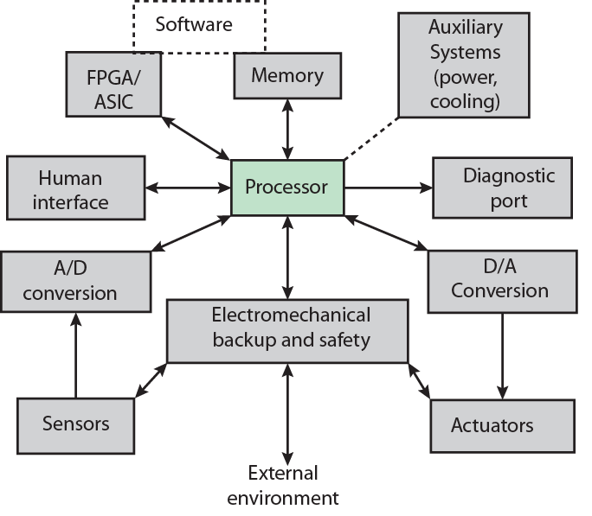
Possible Organization of an Embedded System
FPGA:
Field Prgrammable Gate Array
ASIC:
App Specific Integrated Circuit

Slide 54
ARM Evolution
Designed by ARM Inc., Cambridge, England
Licensed to manufacturers
High speed, small die, low power consumption
PDAs(Personal Data Assistant), hand held games, phones
  E.g. iPod, iPhone
Acorn produced ARM1 & ARM2 in 1985 and ARM3 in 1989
Acorn, VLSI and Apple Computer founded ARM Ltd.

Slide 55
ARM Systems Categories
Embedded real time
Application platform
  Linux, Palm OS, Symbian OS, Windows mobile
Secure applications

Slide 56
Performance Assessment
Clock Speed
Key parameters
  Performance, cost, size, security, reliability, power consumption
System clock speed
  In Hz or multiples of
  Clock rate, clock cycle, clock tick, cycle time
Signals in CPU take time to settle down to 1 or 0
Signals may change at different speeds
Operations need to be synchronised
Instruction execution in discrete steps
  Fetch, decode, load and store, arithmetic or logical
  Usually require multiple clock cycles per instruction
Pipelining gives simultaneous execution of instructions
So, clock speed is not the whole story

Slide 57
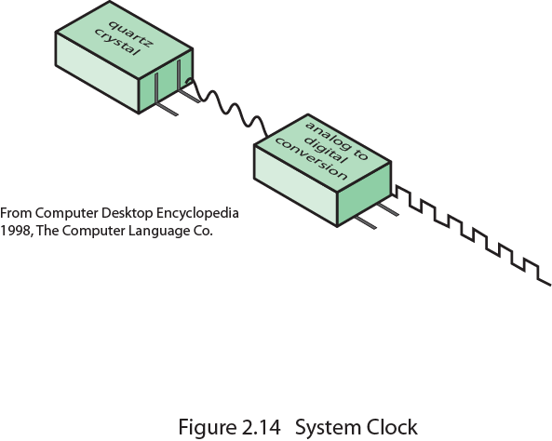
System Clock

Slide 58
Instruction Execution Rate
Millions of instructions per second (MIPS)
Millions of floating point instructions per second (MFLOPS)
Heavily dependent on instruction set, compiler design, processor implementation, cache & memory hierarchy

Slide 59
Benchmarks
Programs designed to test performance
Written in high level language
  Portable
Represents style of task
  Systems, numerical, commercial
Easily measured
Widely distributed
E.g. System Performance Evaluation Corporation (SPEC)
  CPU-2006 for computation bound
    17 floating point programs in C, C++, Fortran
    12 integer programs in C, C++
    3 million lines of code
  Speed and rate metrics
    Single task and throughput

Slide 60

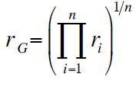
SPEC Speed Metric
Single task
Base runtime defined for each benchmark using reference machine
Results are reported as ratio of reference time to system run time
  Tref_{i} execution time for benchmark i on reference machine
  Tsut_{i} execution time of benchmark i on test system
Overall performance calculated by averaging ratios for all 12 integer benchmarks
  Use geometric mean
    Appropriate for normalized numbers such as ratios

Slide 61
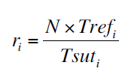
SPEC Rate Metric
Measures throughput or rate of a machine carrying out a number of tasks
Multiple copies of benchmarks run simultaneously
  Typically, same as number of processors
Ratio is calculated as follows:
  Tref_{i} reference execution time for benchmark i
  N number of copies run simultaneously
  Tsuti elapsed time from start of execution of program on all N processors until completion of all copies of program
  Again, a geometric mean is calculated

Slide 62
Amdahl’s Law
Gene Amdahl [AMDA67]
Potential speed up of program using multiple processors
Concluded that:
  Code needs to be parallelizable
  Speed up is bound, giving diminishing returns for more processors
Task dependent
  Servers gain by maintaining multiple connections on multiple processors
  Databases can be split into parallel tasks

Slide 63
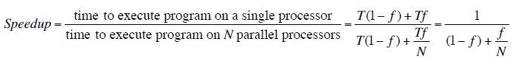
Amdahl’s Law Formula
For program running on single processor
  Fraction f of code infinitely parallelizable with no scheduling overhead
  Fraction (1-f) of code inherently serial
  T is total execution time for program on single processor
  N is number of processors that fully exploit parralle portions of code
Conclusions
  f small, parallel processors has little effect
  N ->∞, speedup bound by 1/(1 – f)
    Diminishing returns for using more processors

Slide 64
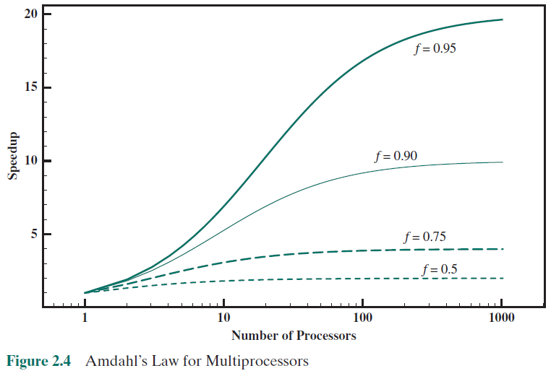
Diminishing Returns for Multiprocessors

Slide 65
Internet Resources
http://www.intel.com/
  Search for the Intel Museum
http://www.ibm.com
http://www.dec.com
Charles Babbage Institute
PowerPC
Intel Developer Home

Slide 66
References
AMDA67 Amdahl, G. “Validity of the Single-Processor Approach to Achieving Large-Scale Computing Capability”, Proceedings of the AFIPS Conference, 1967.

